Slide 1
City of Boston
Building Power Consumption
Team 10
http://vishwashah.pythonanywhere.com/
Jun, Wu
Vishwa, Shah
Avinita, Shetty

Slide 2
Problem statement & solutions
Meter Data Monitoring
Perform macro & micro analysis
Performance measurement
Future power usage forecast
Decision making on power consumption optimization
User friendly interface
Interactive charts & tables
Site/group comparison
Embedded Predictive model
Revenue maximization from demand-response services

Slide 3
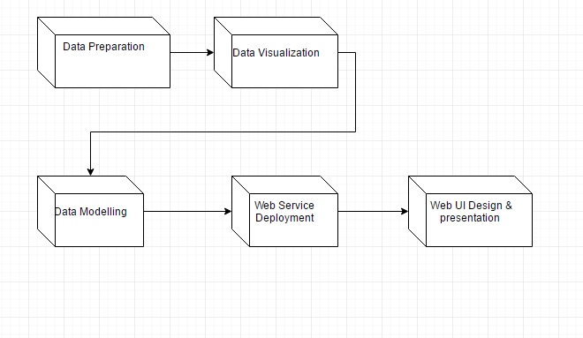
Deployment Pipeline

Slide 4
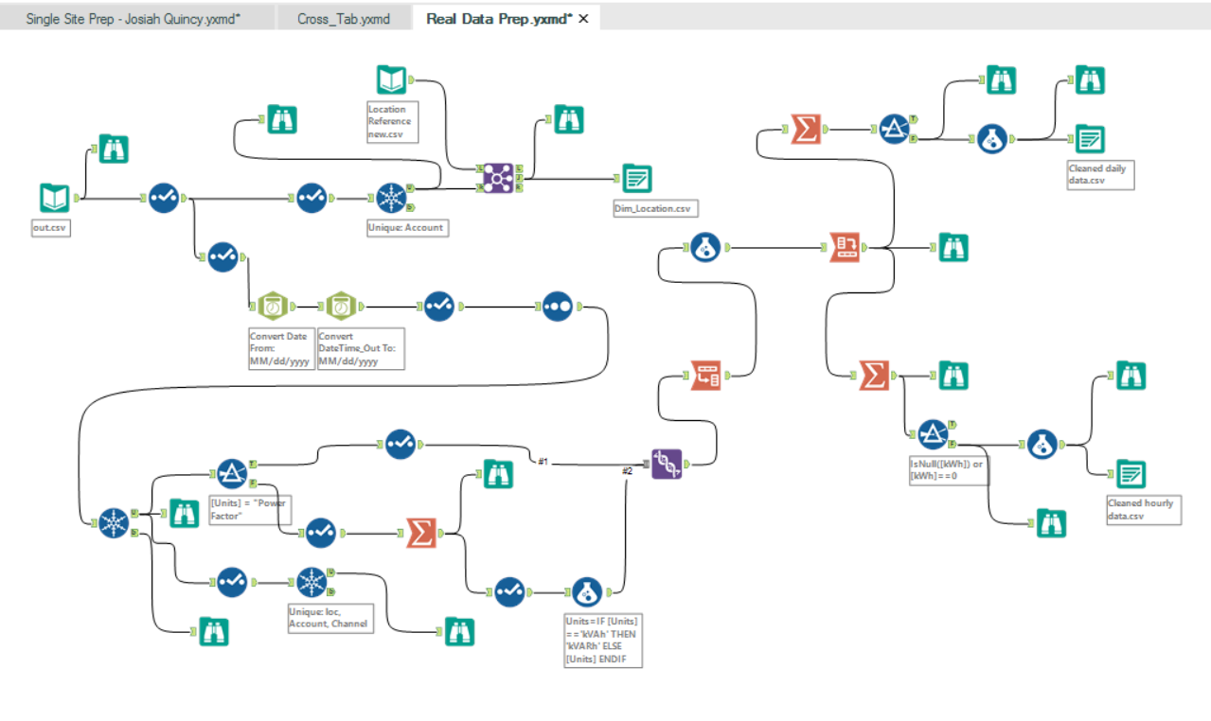
Data Preparation and Cleaning
Tools Used: Alteryx and Python
Python
Combine Files
Pre-process & attach file names
Alteryx
Data clean
Missing data handling
Transpose
Create tables(csv files) based on dimensional model

Slide 5
Data Visualization
Tools Used: PowerBI, Tableau Desktop and Tableau Public/Server
Macro Analysis of all sites by using Daily Data(Aggregating the minute data to daily data) filtered by factor like weather, holiday,weekday and location.
Micro Analysis of Schools
Performance Measure by Power Factor
Published the Tableau visualizations on the Tableau server to help embedding them to the Website.

Slide 6
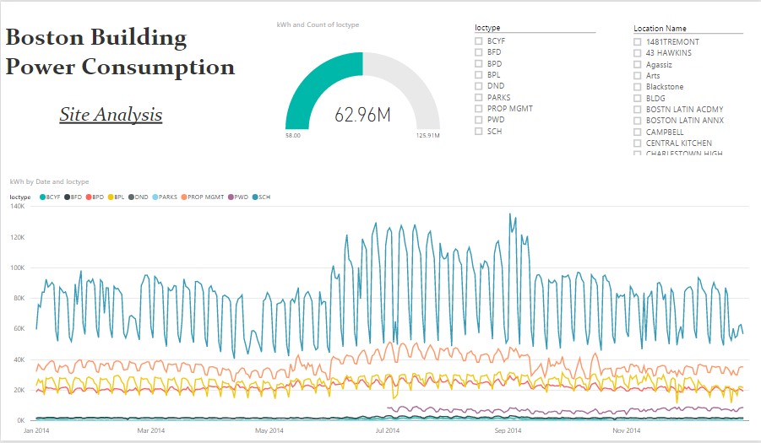
Power BI

Slide 7
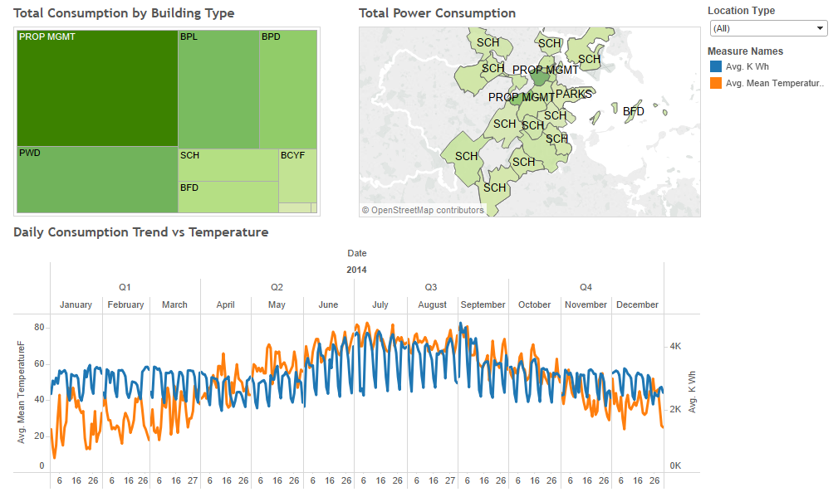
Tableau

Slide 8
Data Modelling
Tools Used: Microsoft Azure Machine Learning Studio and R Studio
Algorithms Used: Boosted Decision Tree and Linear Regression
Steps: Load data from fact & dimension tables
Pre-process & Predictor selection
Build predictive model & Train model
Evaluate & select model

Slide 9
Adding External Data
For the purpose of building model and visualization we added some additional data from:
Weather Data → Weather Underground
Location → Google Maps
Calendar → www.data.gov

Slide 10
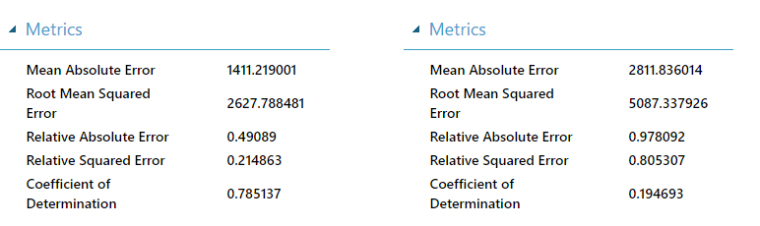
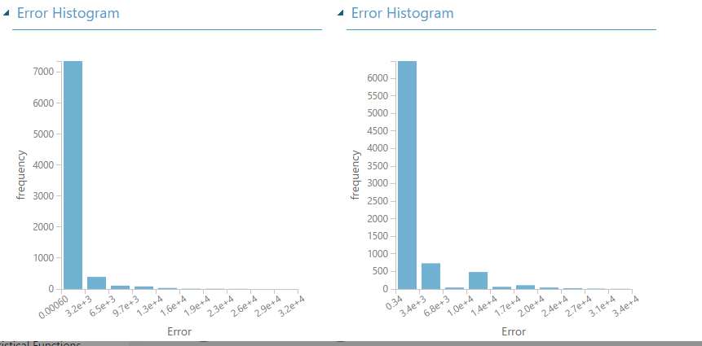

Slide 11
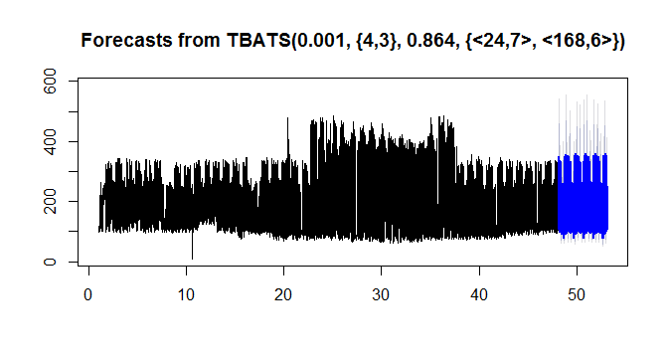
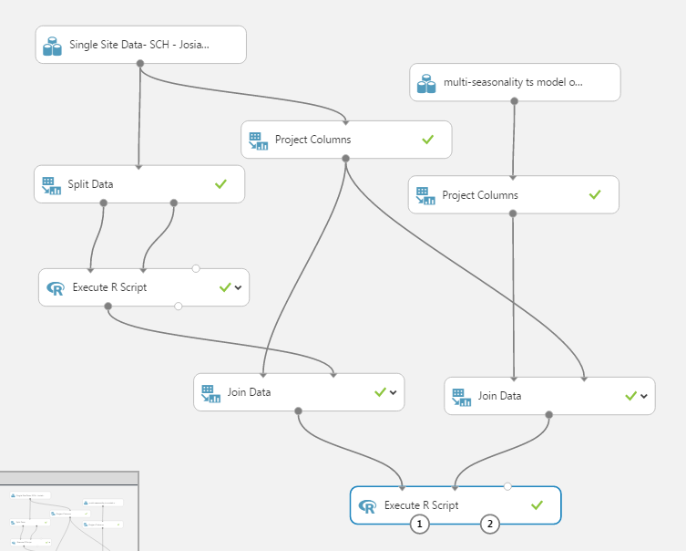
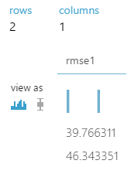
Model Evaluation
Limits: 1. Users need to be domain experts
2. Based on estimated predictor
3. Need 3rd party data
Alternative: Time series prediction for
individual site
Algorithms: ARIMA & TBATS

Slide 12
Web Service Deployment
Framework Used: REST API, Flask Framework, Python, Javascript
Step: 1. For RESTful request dispatching, we have used Flask Framework for Python

Slide 13
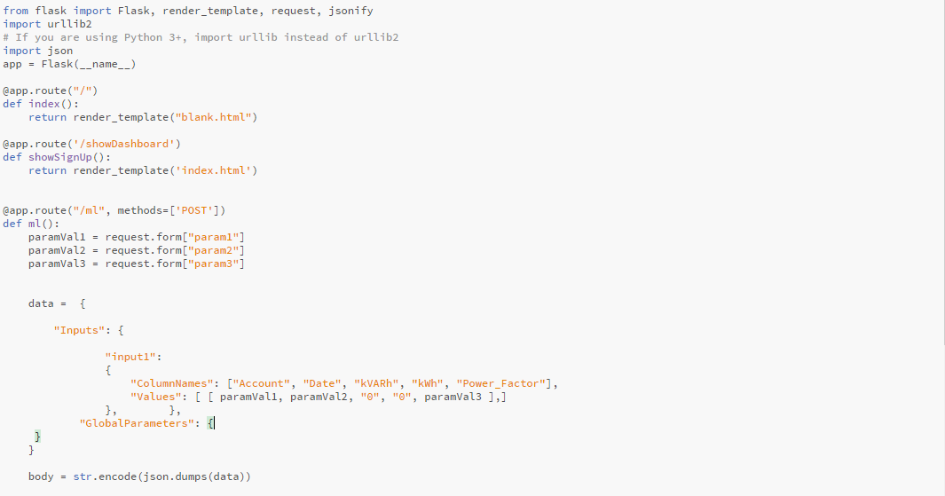
Flask Framework

Slide 14
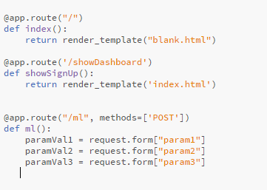
2. Redirected the HTML pages in the server
3. The user inputs 3 parameters: Date, Account
Number and estimated Power Factor

Slide 15
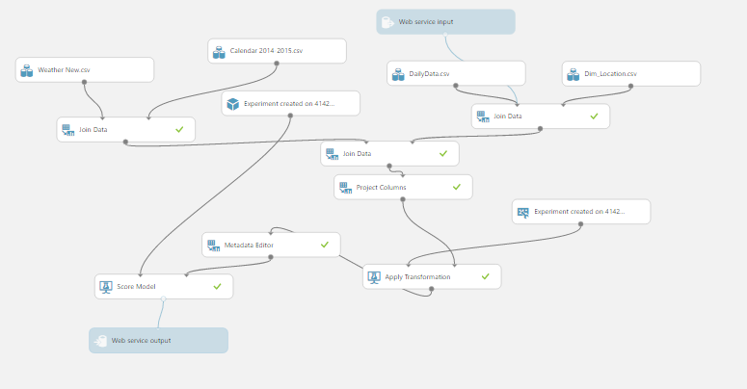
Deploy Web Service

Slide 16
Web UI and Presentation
Tools Used: Javascript, Bootstrap, JQueryUI, Font Awesome
For Front-end, Bootstrap components like buttons, header and Datepicker have been used
Font-awesome is used for certain icons on the web page
JQuery-UI is used for tabs

Slide 17
Q & A

